Slide 1

ANALYZING AND PREDICTING STOCK PRICES THROUGH TWEET
SENTIMENT

Slide 2

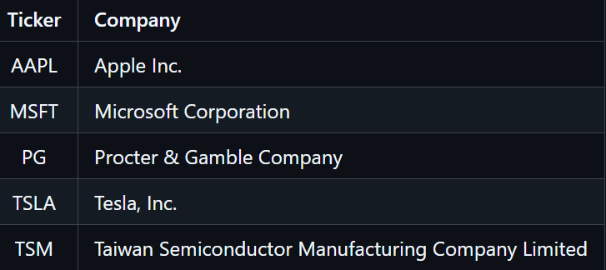
Objective
Models Leveraged:
Our objective is to examine how stock prices are influenced and explore the potential correlation between company/stock sentiment in daily tweets for the top 5 companies.
Data Source: Kaggle: Stock Tweets for Sentiment Analysis and Prediction
The dataset comprises tweets about the top 25 most-watched stock tickers on Yahoo Finance from September 30, 2021, to September 30, 2022.
License: CC0: Public Domain
Prophet Forecasting Model
Convolutional Neural Network (CNN)
Long Short-Term Memory (LSTM)

Slide 3
Prophet Model Implementation

Slide 4
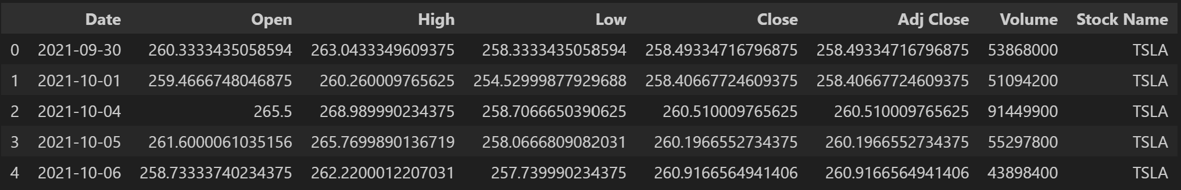
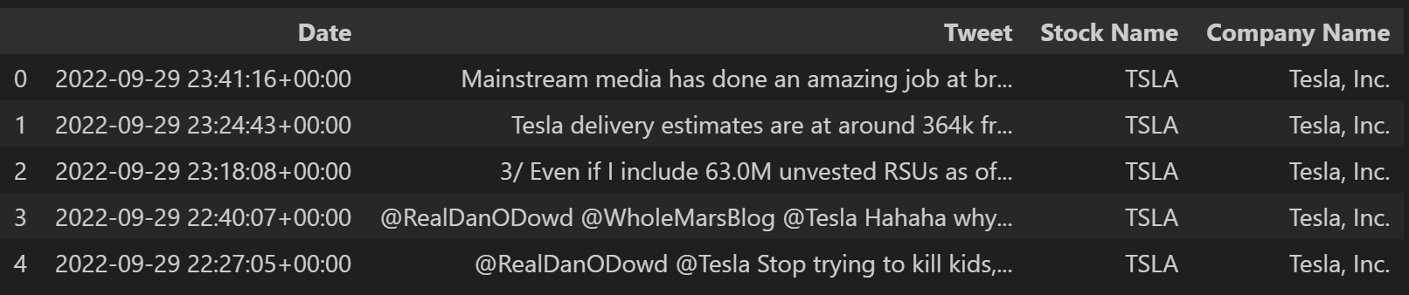
Stock Data & Tweet Data Preprocessing
Reviewed dataframe shape and columns
Evaluated data types
Filtered data to specific stocks relevant to the
project
Identified and addressed null and blank values

Slide 5
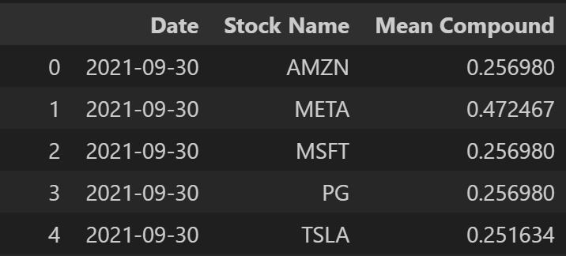
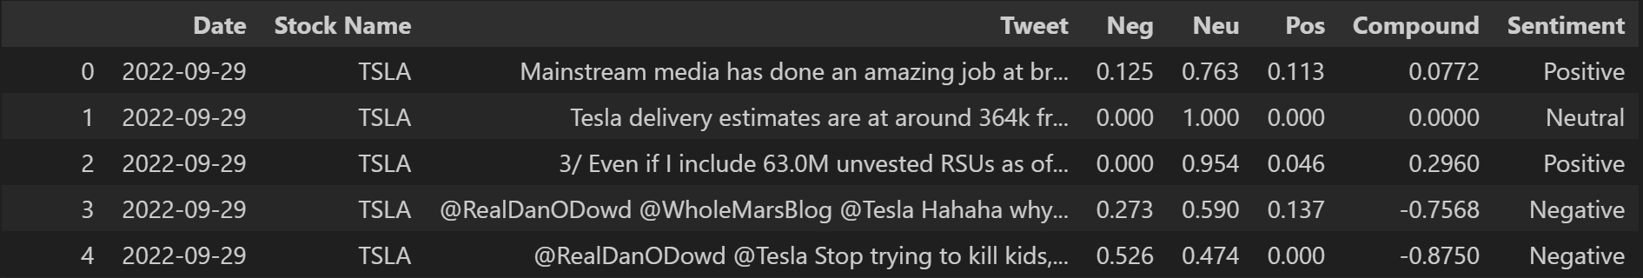
Implementation of VADER Sentiment Analyzer
Initialized the Sentiment Analyzer as a function to analyze each tweet
Assigned sentiment labels based on the scoring scale:
Positive: compound score ≥ 0.05
Neutral: -0.05 < compound score < 0.05
Negative: compound score ≤ -0.05
Added columns for Positive, Neutral, Compound, and Sentiment
Grouped tweet data by Date and Stock Name and calculated a Mean Compound score for each date
Merged Tweet and Stock dataframes
Applied MinMaxScaler

Slide 6
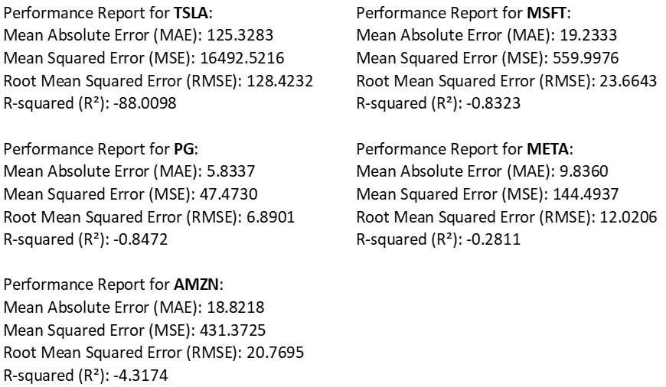
Initial Model Training And Testing
Implemented training and testing loop for each stock
Mapped 'Sentiment' values as an integer
Split data into training and testing sets
Added 'Mean Compound' as a regressor
Fit the model and made predictions
Calculated and displayed metrics for each loop

Slide 7
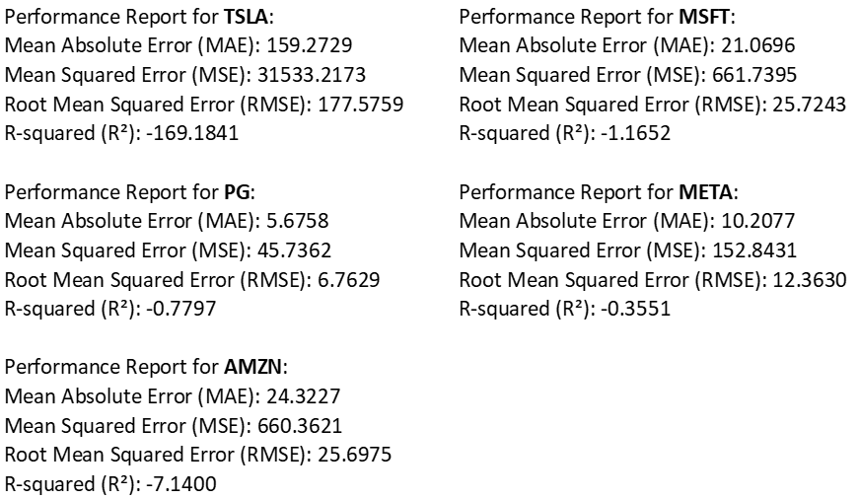
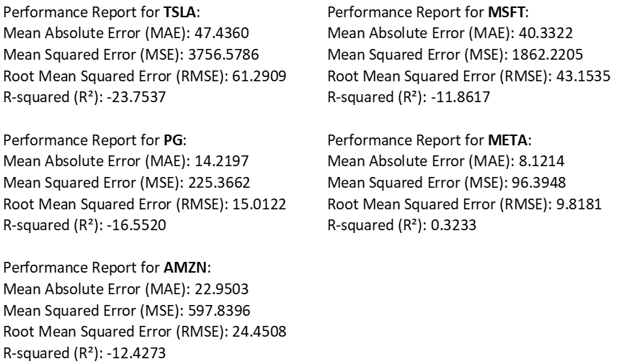
Secondary Model Training and Testing
Implemented a new training and testing loop for each stock
Mapped 'Sentiment' values
Created a 60-day rolling closing price average
Split data into training and testing sets
Added Regressors:
'Mean Compound'
'Volume'
'Sentiment'
60-day closing price average
Incorporated changepoint prior scale
Fit the model and made predictions
Calculated and displayed metrics for each loop
80% Training Sample
90% Training Sample

Slide 8
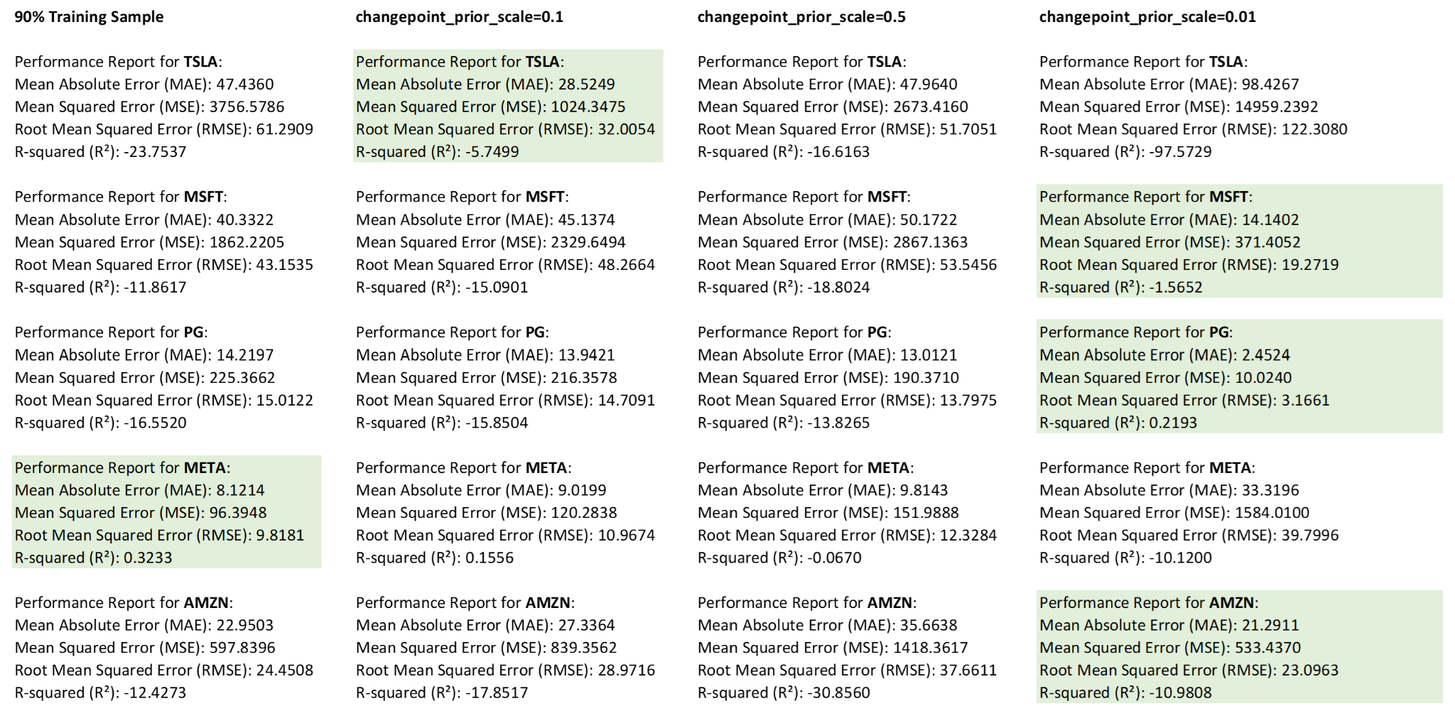
Introduction of Changepoint Prior Scale Sensitivity

Slide 9
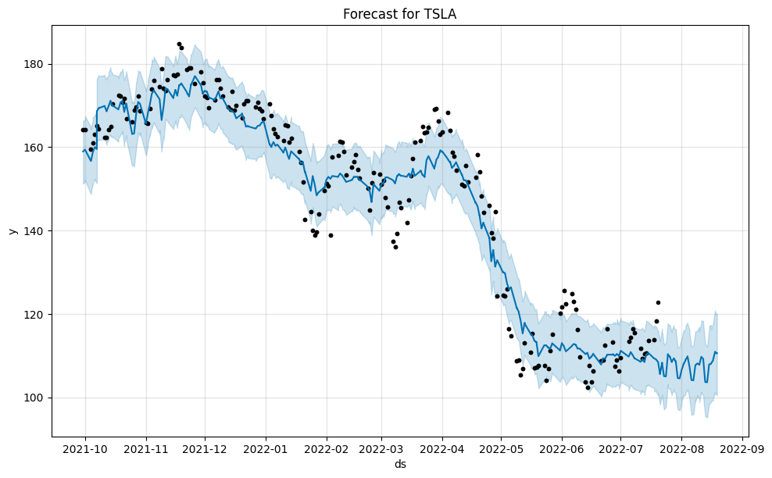
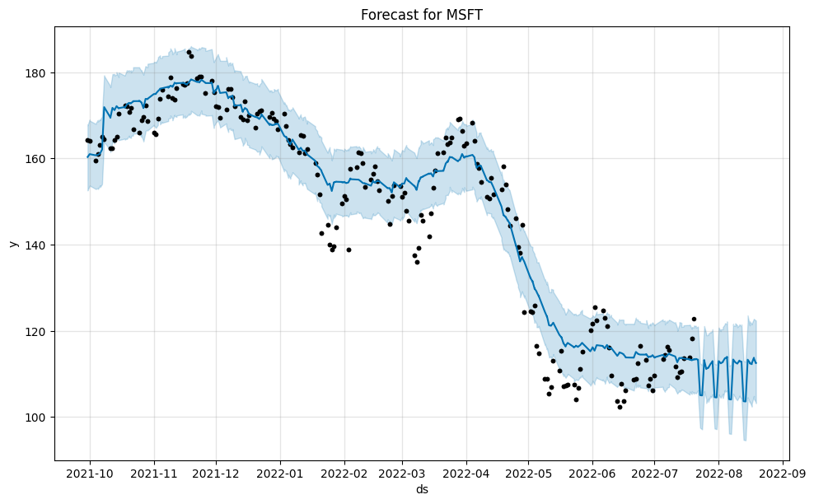
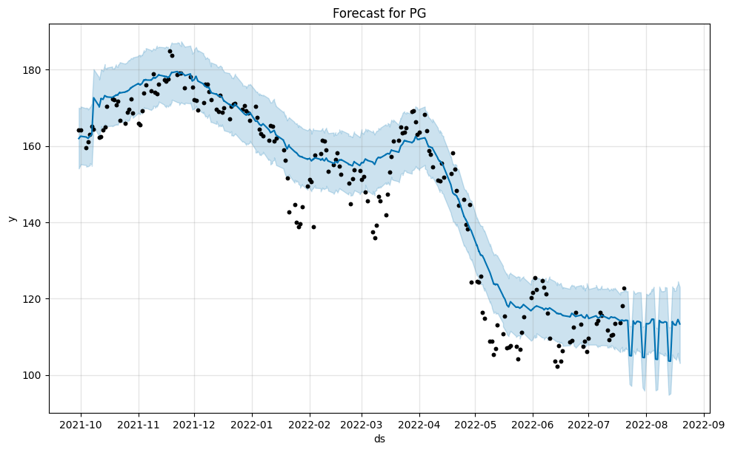
Prophet Visualizations

Slide 10
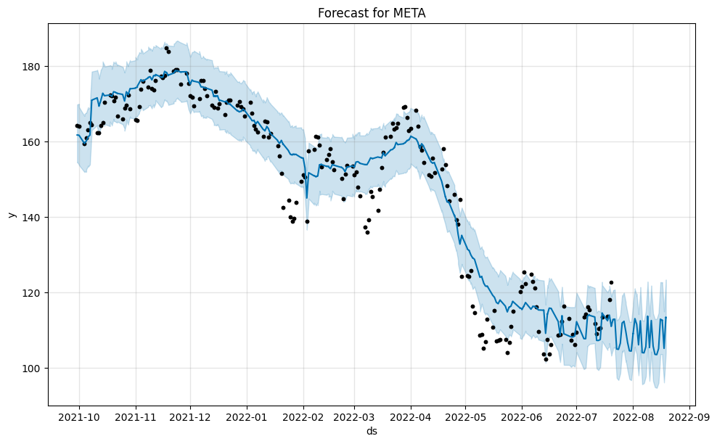
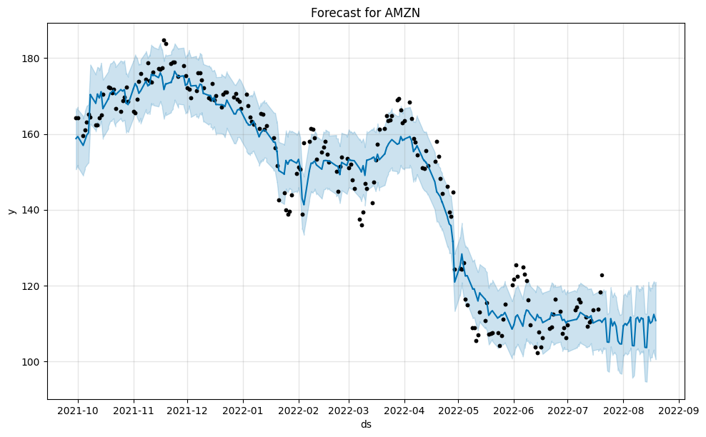
Prophet Visualizations

Slide 11
Prophet Model Conclusions and Next Steps
Overall Performance Summary:
The negative R-squared values indicate that the Prophet model is underperforming and struggling to capture the volatility or trends in these stocks, particularly with volatile stocks like TSLA and AMZN.
The high MAE and RMSE Values indicate that the model's predictions are off from the actual values.
Possible Reasons for Poor Performance:
Limited data: When broken down by specific stocks, the data sets are much smaller than the complete dataset.
Stock Volatility: Prophet may struggle to effectively handle highly volatile stocks. Prophet is better suited long-term trends but it may not capture fluctuations and non-linear patterns commonly seen in stock prices.
With prophet mainly using time-based features the included regressors may not be sufficient to explain the complexity of stock price movements.
Model Limitations: Stock data is highly influenced by external events, news, and market conditions, which are not easily captured by the time-series model.
Next Steps:
Additional features could be added, including external factors such as economic indicators like interest rates, inflation and consumer confidence.
With stock price movements often having complex, non-linear relationships, trying machine learning models like Random Forests, or deep learning models like LSTM (Long Short-Term Memory) networks could be used to capture more complex patterns more accurately.

Slide 12
Convolutional Neural Network (CNN)

Slide 13

CNN MODEL STEPS
Data Preprocessing
Model Creation
Model Tuning
Model Application

Slide 14
CNN DATA Preprocessing
Create and apply a date function to extract date information from a datetime column.
Use Vader to generate sentiment scores for tweets in the stock_tweet dataframe.
Feature Engineering:
Add a column to count the number of tweets for each company daily.
Add a column to calculate the difference between opening and closing prices.
Add a column to calculate the difference from the previous closing price.
Merge the stock_tweet and stock_yfinance dataframes.
Isolate the Close column as the target variable.
Separate the stock dataframe into numerical and categorical data frames for normalization.
Normalize numerical data using StandardScaler.
Normalize categorical data using pandas get_dummies function with integer dtype.
Combine categorical and numerical data frames to create final_stock_df.
Fill any missing values.
Save final_stock_df to CSV as final_stock_data.csv.

Slide 15
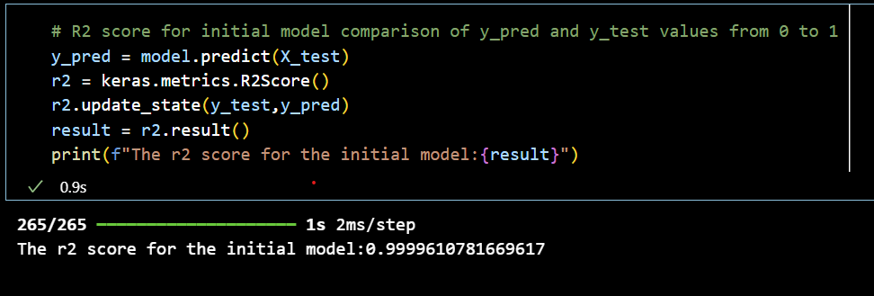
CNN MODEL CREATION:
Load Data
Define the stock_df dataframe from final_stock_data.csv
Prepare data
Define x to include all features from stock_df except the close function
Define y as the close function
Split x and y into training and testing datasets.
Build CNN Model
Used linear regression as the model focus
create a total of 7 Dense layers:
input layer with 18 nodes
output layer with 1 node
Set activation function to ‘relu’ for all layers except the output layer, which uses ‘linear’.
Compile Model
Use mean absolute percentage error as the loss metric, as accuracy is not suitable for this problem.
Train Model
Achieve a loss of approximately 0.15% and a mean absolute error of 0.39.
The R² score, indicating how close the predicted values are to the actual values, is 0.99996.

Slide 16
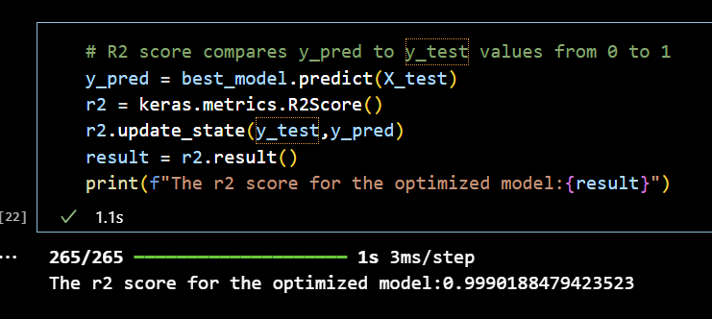
CNN MODEL TUNING
Define Model Function
created a create_model function that follows the same methodology as the previous model, with adjusted hyperparameters for each run
Optimize Hyperparameters
utlizized keras_tuner to run the create_model function 60 times to identify the optimal model and hyperparameters
Evaluate Best Model
Calculated the R² score for the best model, which is 0.99902
Compare Predictions
Compared y_test and y_pred values, with most predictions differing by less than 1 point
y_test (true value) | y_pred (predicted value)
264.84 | 263.98

Slide 17
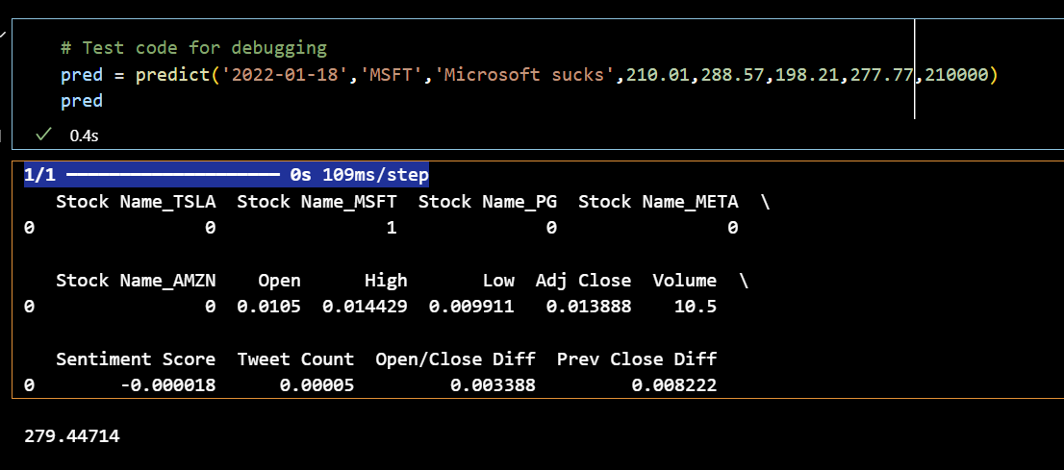
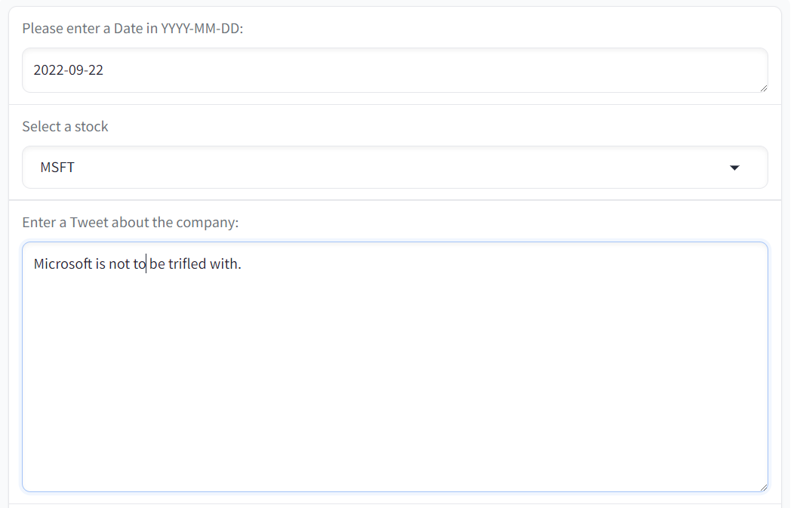
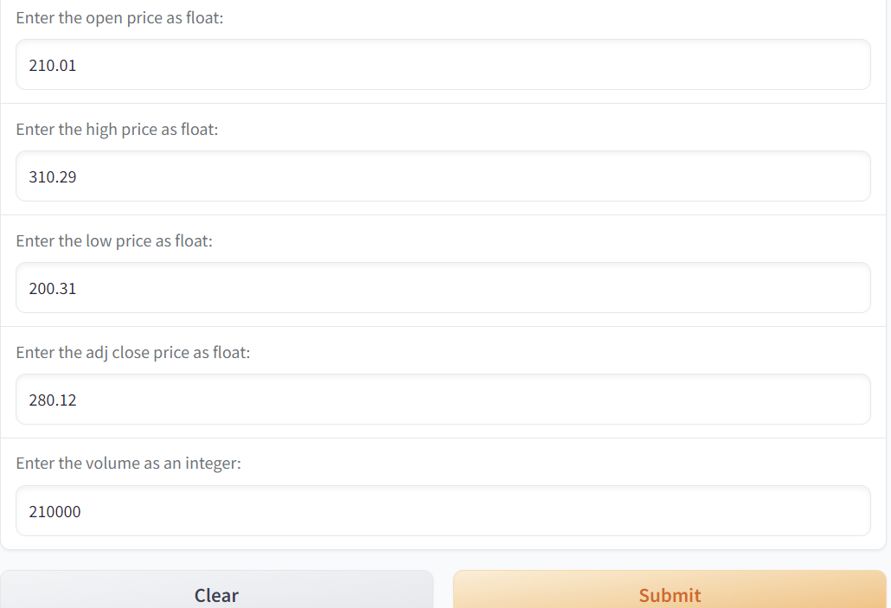
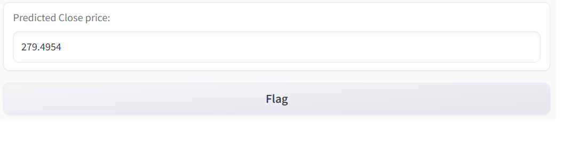
CNN MODEL APPLICATION:
Define Prediction Function
Create a predict function to process user-input data and predict the Close value.
Test Functiontionality
Validate the code to ensure it performs as expected
Build and Deploy Application
Develop the application using Gradio and execute it.

Slide 18
Long Short-Term Memory (LSTM)
Notes:
their ability to process time series and recognize long-term data dependencies efficiently.

Slide 19

LTSM STEPS
Data Preprocessing
Merging and Cleaning
Function Structure
Model Creation
LSTM Model Structure
Compile the model
Train the model
Model Application

Slide 20
LTSM DATA PREPROCESSING
Extract data information
create and apply a function to extract the date from the datetime column in both dataframes
Sentiment Analysis
Use VADER to generate sentiment scores for tweets in the stock_tweet dataframe
Feature Engineering
Daily Tweet Count
Add a column to count the number of tweets a company receives each day
Open/Close Price Difference
create a column to calculate the difference between the opening and closing stock prices
Previous Close Price Difference
add a column to compute the difference between the previous days and the current day's closing prices

Slide 21
Merging and Cleaning
Merge Dataframes
Combine stock_tweet and stock_yfinance dataframes based on date and Stock Name
Isolate Target Variable
Extract the close column as the target variable for prediction
Prepare Data for Normalization
Split the Dataframe into numerical and categorical Dataframes
Normalize data
Apply MinMaxScaler to the numerical Data
Combine Data
Merge the normalized numerical and categorical data frames to create merged_data
Handle Missing Values
Remove any NA values

Slide 22
Function Structure
analyze_tweets()
create_sequences()
fetch_recent_stock_data()
train_model()
predict_next_day_close_yfinance()
predict_stock_price()
elevate_model()

Slide 23
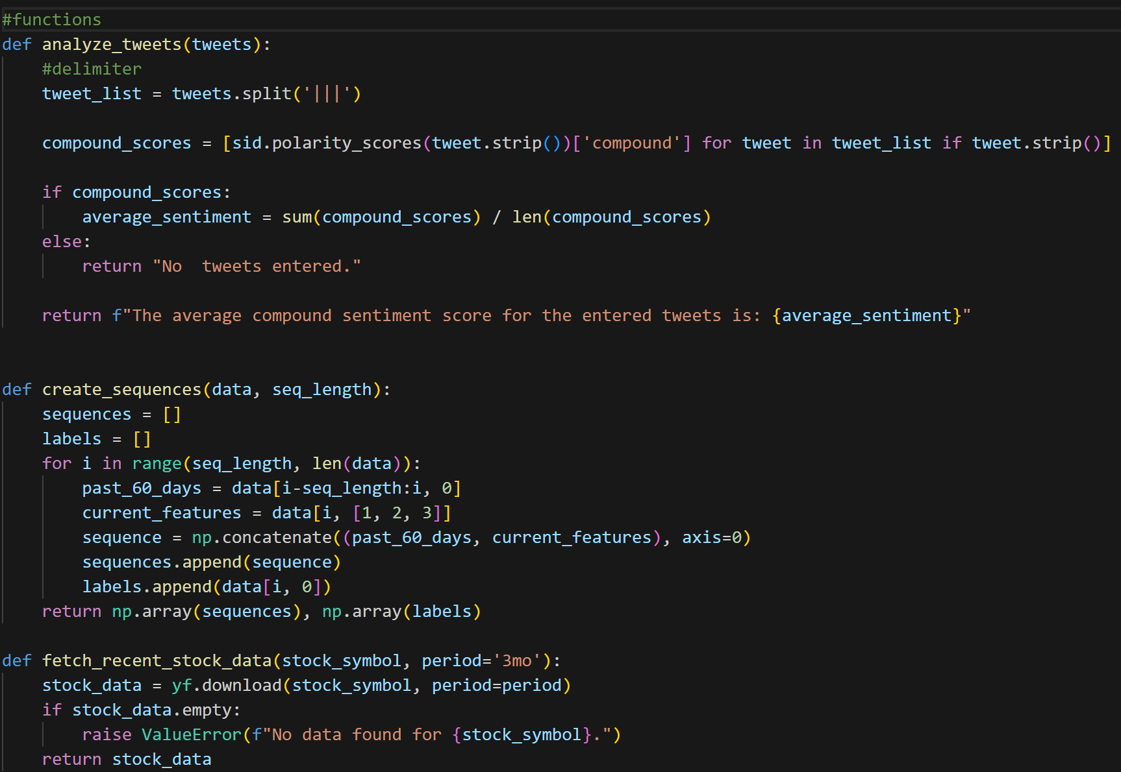
analyze_tweets
Analyzes the sentiment of user-inputted tweets.
create_sequences
Generates sequences of 60 days of stock data for LSTM model training.
fetch_recent_stock_data
Retrieves the latest stock data using yfinance.

Slide 24
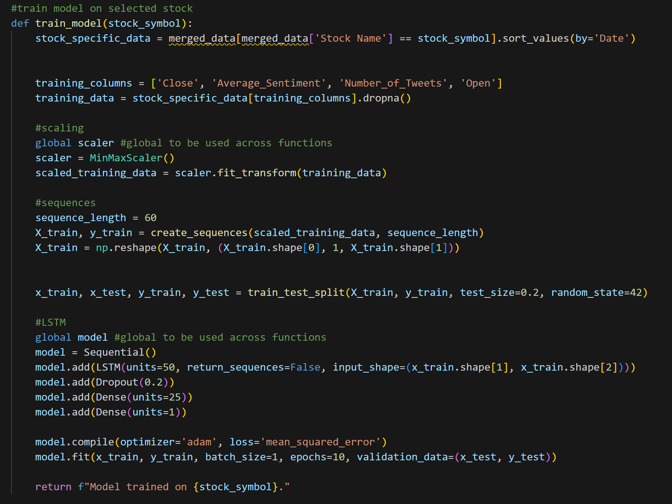
train_model
Trains the LSTM model using the selected stock data.

Slide 25
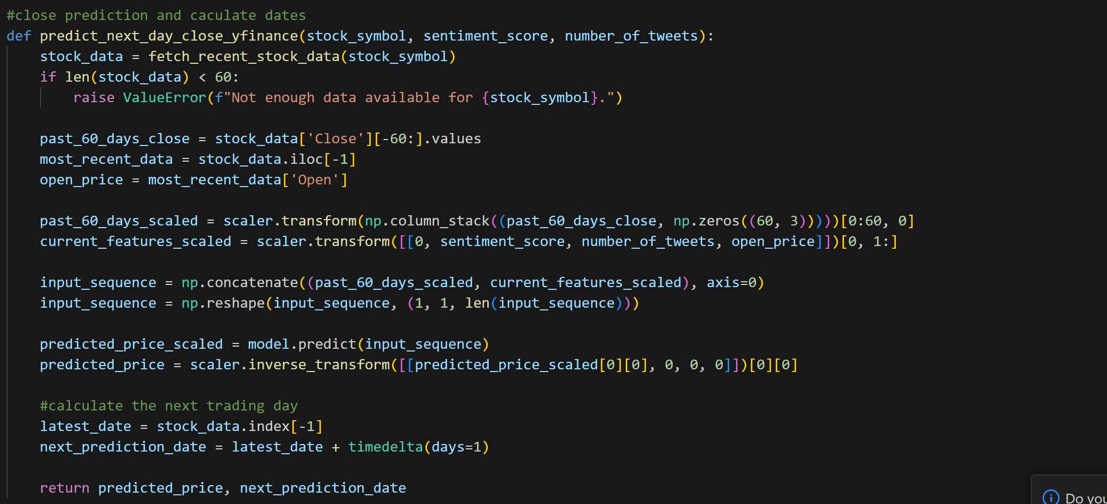
predict_next_day_close_yfinance
Forecasts the next day's closing stock price with the trained LSTM model.

Slide 26
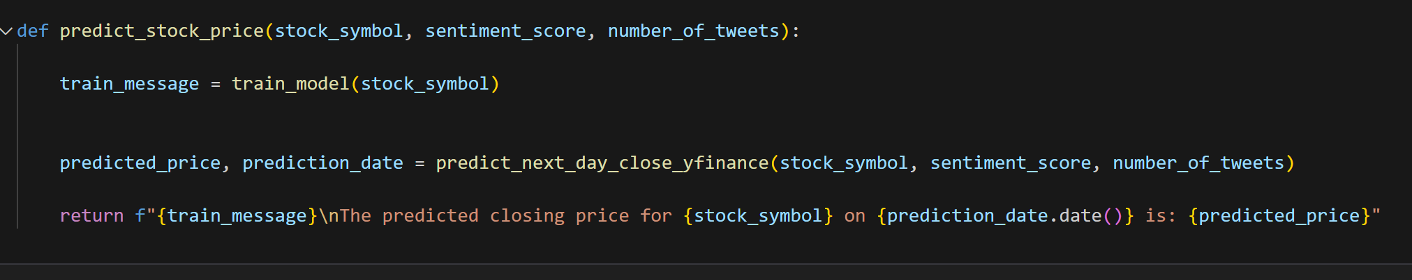
predict_stock_price
Provides the final stock price prediction output through Gradio
Gradio Interface:
Stock Price Prediction Tab
Used for training the model and making stock price predictions.
Tweet Sentiment Analysis Tab
Analyzes the sentiment of multiple tweets..

Slide 27
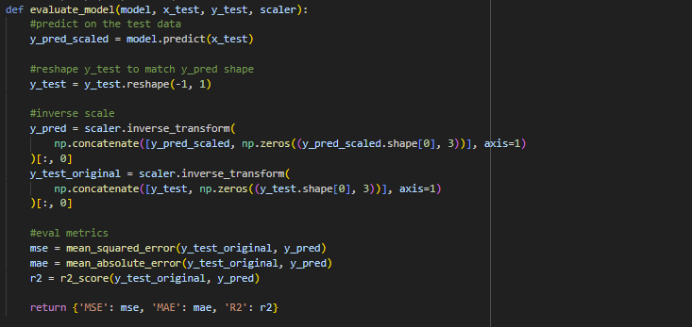
evaulate_model
Provides metrics based on model performance.

Slide 28
MODEL CREATION
Load Data
Define the stock_df dataframe by loading final_stock_data.csv.
Prepare Variables
Define X as all features from stock_df except the Close column.
Define y as the Close column (target variable).
Split Data
Use train_test_split to divide X and y into training and testing datasets.

Slide 29
LSTM MODEL STRUCTURE
Model Architecture
Sequential Model: Utilized a sequential model structure.
LSTM Layer: 50 units to capture time-series dependencies.
Dropout Layer: 20% dropout rate to mitigate overfitting.
Dense Layer: 25 units for dense feature representation.
Output Layer: 1 unit to predict the stock’s closing price.
Activation Functions
Hidden Layers: ReLU activation function.
Output Layer: Linear activation function.

Slide 30
Compile the Model:
Loss Function and Optimizer
Set the loss function to Mean Squared Error (MSE).
Used the Adam optimizer.
Train the Model:
Training Process
Trained using X_train and y_train.
Batch size: 1
Epochs: 10
Validation set: X_test and y_test.
Model Application:
Prediction Function
Processes user-input data (e.g., stock symbol, sentiment score, tweet count, open/close prices) to predict the next day's closing stock price.

Slide 31
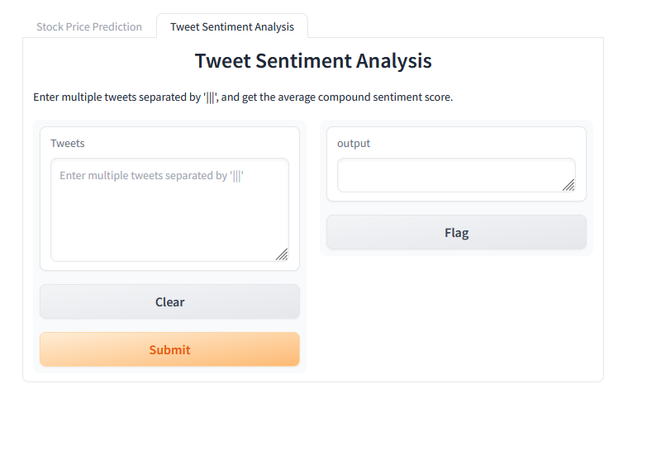
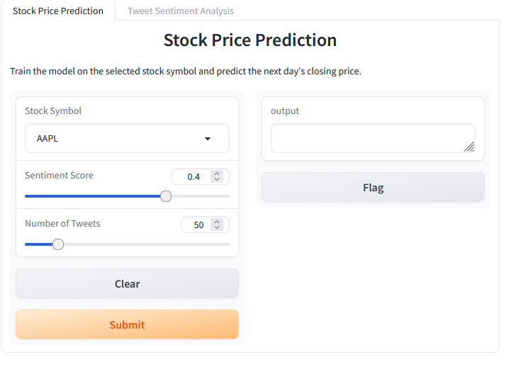
LSTM Prediction
Notes:
https://6c4f4319db69498f3e.gradio.live/

